Slide 1

consumer
Back-Office
3’rd party
employee
Security Solution
User Engagement/Digital Engagement Layer/Presentation Layer
User Web Browser/Digital Engagement Layer/Presentation Layer
Analytics /Business Intelligence Solution
Solution - A
Component – 3
Component – 1
Component – 3
DR Level : Cold
Application Server Performance – HA,Failover,Multisite clustered HA,
Deployment Tech – VM/Container/BareMetal
Component – 2
HR System
Finance System
Business Support system
Storage Server – Solution A
DR - Storage Server – Solution A
DR Level : Cold
Application Server Performance – HA,Failover,Multisite clustered HA,
Deployment Tech – VM/Container/BareMetal
Storage
Instance Name
DR mechanism
DR Storage
DR Level : Cold
Application Server Performance – HA,Failover,Multisite clustered HA,
Deployment Tech – VM/Container/BareMetal

Slide 2
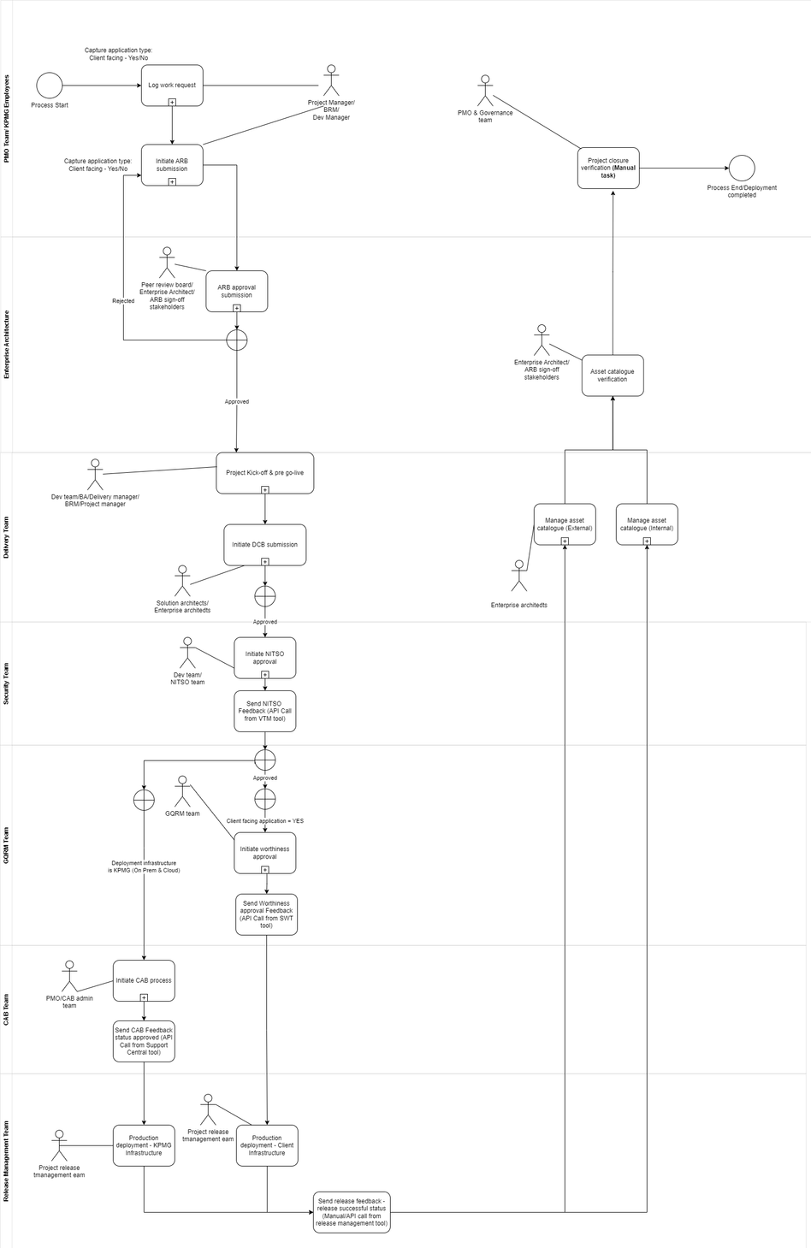
Business Process

Slide 3
Solution - A
Baseline
Transition - 1
Target
Phase-In(Start) – Date
Phase-In(End) – Date
Phase-Out(start) – Date
Phase-Out(End) - Date
Phase-In(Start) – Date
Phase-In(End) – Date
Phase-Out(start) – Date
Phase-Out(End) - Date
Phase-In(Start) – Date
Phase-In(End) – Date
Phase-Out(start) – Date
Phase-Out(End) - Date

Slide 4
Solution - A
Integration Pattern
API Based
Solution - B
Information Set/
Data Entity Name
Information Set/
Data Entity Name
Active Directory
Information Set/
Data Entity Name
Integration Pattern
File Based
Solution - C
Information Set/
Data Entity Name

Slide 5
Solution - A
Component – 1(Login)
Component – 2(Business Function-1)
Component – 2(Business Function-2)
Component – 2(Monitoring)
Programming Languages
Technology - B
Technology - B
Technology - B
Technology - B
IDE
Technology - C
Technology - C
Technology - C
Technology - C
Server Side OS
Technology - D
Technology - D
Technology - D
Technology - D
Client Side OS
Technology - E
Technology - E
Technology - E
Technology - E
Monitoring & Diagnostics
Technology - G
Technology - G
Technology - G
Technology - G
Application Runtime Framework
Technology - H
Technology - H
Technology - H
Technology - H
Source Code Management
Technology - I
Technology - I
Technology - I
Technology - I
Database Application
Technology - J
Technology - J
Technology - J
Technology - J
Database OS
Technology - K
Technology - K
Technology - K
Technology - K

Slide 6
Dev Environment
QA Environment
Production Environment
Source Code
Source Code
Source Code
Deployment Pattern
Configuration
Deployment Pattern
Configuration
Deployment Pattern
Configuration
Monitoring Component
Monitoring Component
Monitoring Component

Slide 7

Monitoring and Incident Management
Backup and job scheduling
Solution - A
Solution - A
Send Monitoring and
diagnostics information
Send Monitoring and
diagnostics information
Scheduling Requirement
Enterprise Monitoring Solution
Backup Solution
Enterprise Scheduling Technology
Raise Incident and
allocate as per the SLA.
Enterprise Incident Management
Non – Monitored Components and RISKS associated
Component – 1(Login)

Slide 8
Authentication Technology
(Active Directory/Identity and Access Management)
Solution - A
Authenticate
Computer Location(KPMG DC)
Computer Location(Roaming)
user
admin
user
3’rd party

Slide 9
Solution - A
Technology
(Active Directory/Identity and Access Management)
User Privilege
Authorize
Computer Location(KPMG DC)
Computer Location(Roaming)
user
admin
user
3’rd party

Slide 10
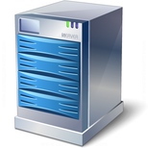
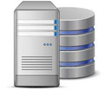




Firewall
Firewall
Internet
DMZ
Corporate Network
KPMG Cloud Subscription
Security Layer
Presentation Layer
Application Server
Database Servers
App server
Database server
KPMG Cloud Subscription
WAF
VM
Cloud Computing
Load balancer
Public Cloud
Proxy
App2
App1
Intranet
user
Admin

Slide 11
Solution - A
Think Mobility for front-end application
API First
Single Capability
Unified Architecture Governance
Data is an Asset
Virtual Deployment Preferred
No, Prefers custom APIs
Leverage off-the-shelf integration
Configure , do not customize
Governed Integration
Think Cloud first

